Slide 1
Spatial Data Introduction
OGC simple features
mike johnson

Slide 2
Goal of these slides
Introduce you to some core geospatial (vector) basics, jargon and standards
Introduce point, line, and polygon geometry construction
Know what WKT , WKB, GDAL, GEOS and OGC stand for
Not the Goal of these slides
Introduce Java code
code snippets are in R (this is to get you you thinking about concepts, not code)
This is also to introduce existing bindings to spatial databases such as GDAL, GEOS, and POSTGIS including error handling and reporting

Slide 3
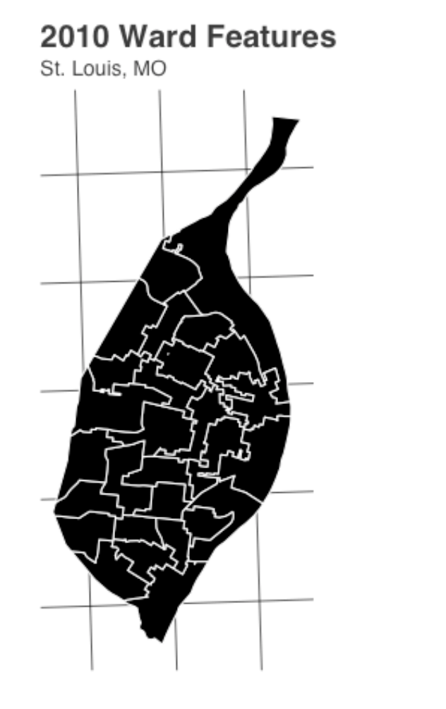
Spatial Data
Two flavors of spatial data … each has their own unique representation, operations, applications, and suitability
RASTER | VECTOR
GRID (RESOLUTION, EXTENT, PROJECTION) | GEOMETRIES (Collection of points)
Continuous | Discrete
Single Value | Multi-attribute
Can you think of two variables – one that would best be represented by raster and one best represented as vector?

Slide 4
Coordinate Systems think geog12, intro GIS, ect…
Conversion formulas
x=r cosϕ
y=r sinϕ
ϕ=arctan(y/x)
r=sqrt(x2+y2)
** Be aware of quadrant for proper arctan conversions…
: origin
Red : Geodetic coordinates
Blue: Cartesian Coordinates

Slide 5
The OGC
The Open Geospatial Consortium (OGC) is an international non-profit organization committed to making quality open standards for the global geospatial community.
Standards are made through a consensus process and are freely available for anyone to use to improve sharing of the world's geospatial data.
Vision:
A world in which everyone benefits from the use of geospatial information and supporting technologies.
Mission:
To advance the development and use of international standards and supporting services that promote geospatial interoperability. To accomplish this mission, OGC serves as the global forum for the collaboration of geospatial data / solution providers and users.

Slide 6
OGC Simple Feature Access
Simple Features (officially Simple Feature Access) is both an OGC and International Organization for Standardization (ISO) standard that specifies a common storage and access model of mostly two-dimensional geometries used by geographic information systems.
Part one of the standard defines a model for two-dimensional simple features, with linear interpolation between vertices. This part also defines representation using Well-Known Text (and Binary).

Slide 7
The `Big 7` Geometries
Type | Description
POINT | single point geometry
MULTIPOINT | set of points
LINESTRING | two or more points connected by straight lines
MULTILINESTRING | set of linestrings
POLYGON | Closed linestring ring with zero or more inner rings (holes)
MULTIPOLYGON | set of polygons
GEOMETRYCOLLECTION | set of the any above geometries

Slide 8
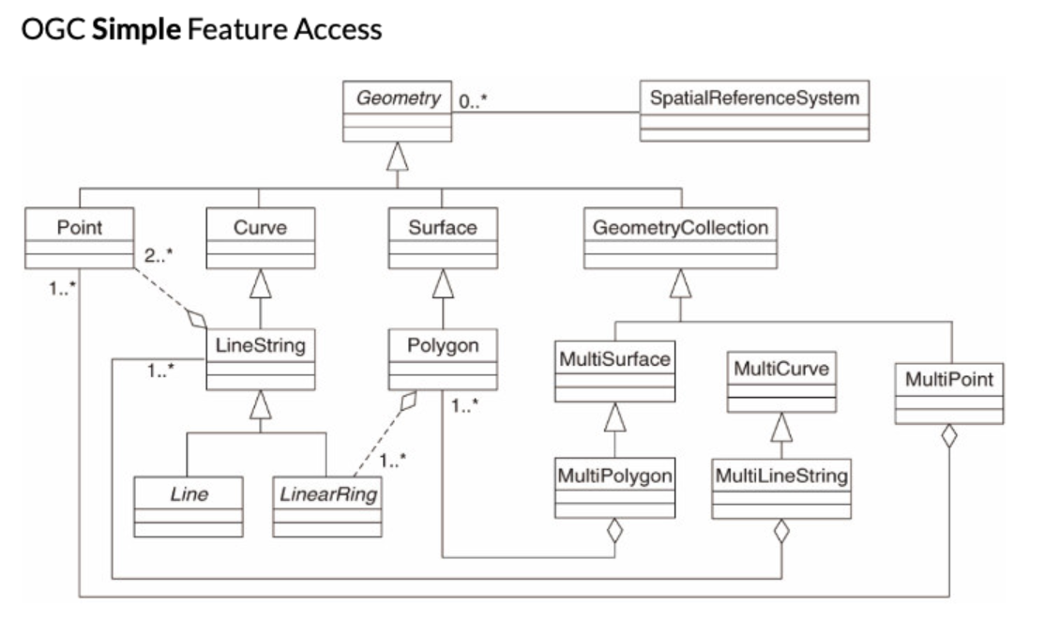

Slide 9
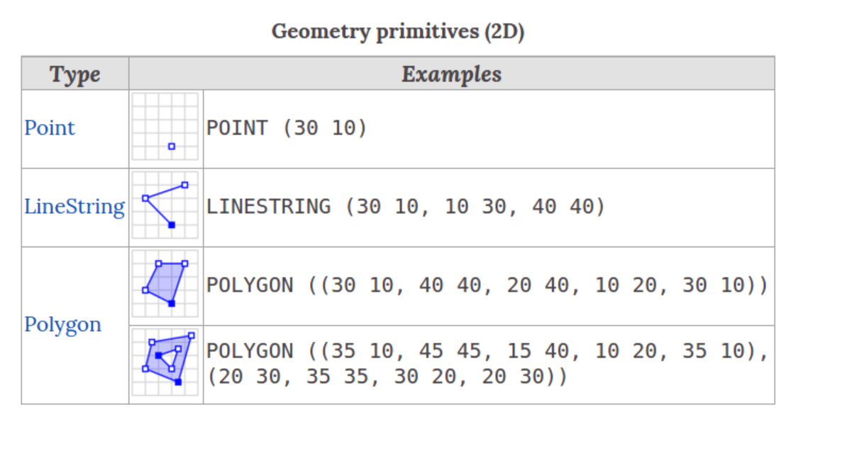

Slide 10
Well-Known Text (WKT)
Text markup language representing vector geometry
Originally defined by the OGC (Open Geospatial Consortium) and described in the Simple Features Access and Coordinate Transformation Services
Fully described here
In total, there are 18 distinct geometry objects that can be represented
Meant to be human readable

Slide 11
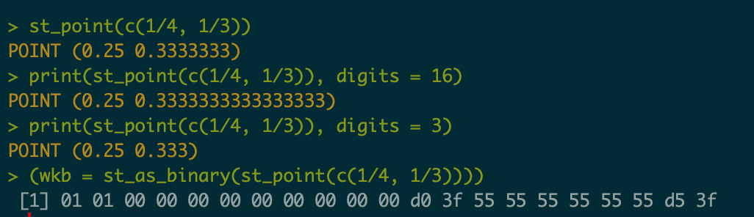
Well Known Text Binary (WKB)
Binary conversion is used to communicate geometries to external libraries (GDAL, GEOS, liblwgeom) and spatial databases
GDAL = geospatial data abstraction library
GEOS = Geometry Engine Open Source
Liblwgeom = “Light Weight Geom”
Meant to be machine readable

Slide 12
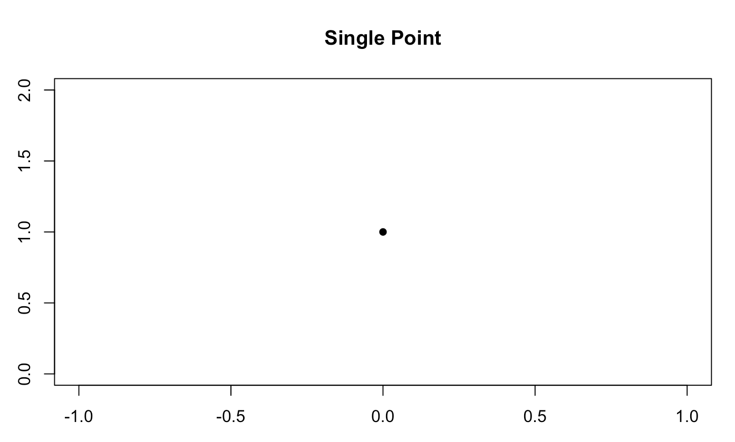
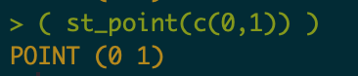
POINT()
A point is the base vector unit
Comprised of an ordered `XY` coordinate (can include Z, M – eg `XYZ`)
X, Y Coordinate
(Cartesian)
Create a point (st is an R, POSTGIS an
and GDAL convention for ‘spatio-temporal’)
WKT String

Slide 13
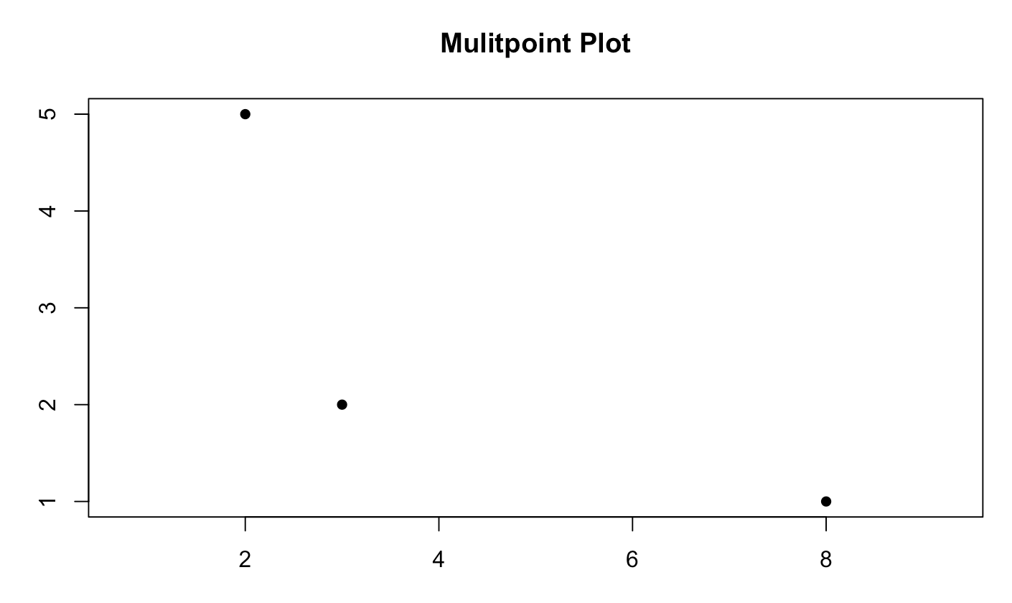
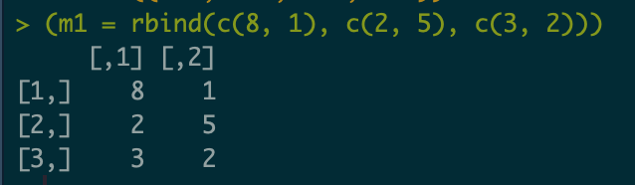
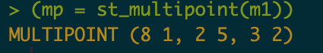
MULTIPOINT()
X, Y Coordinate
(Cartesian)
Create a point multipoint
WKT String

Slide 14
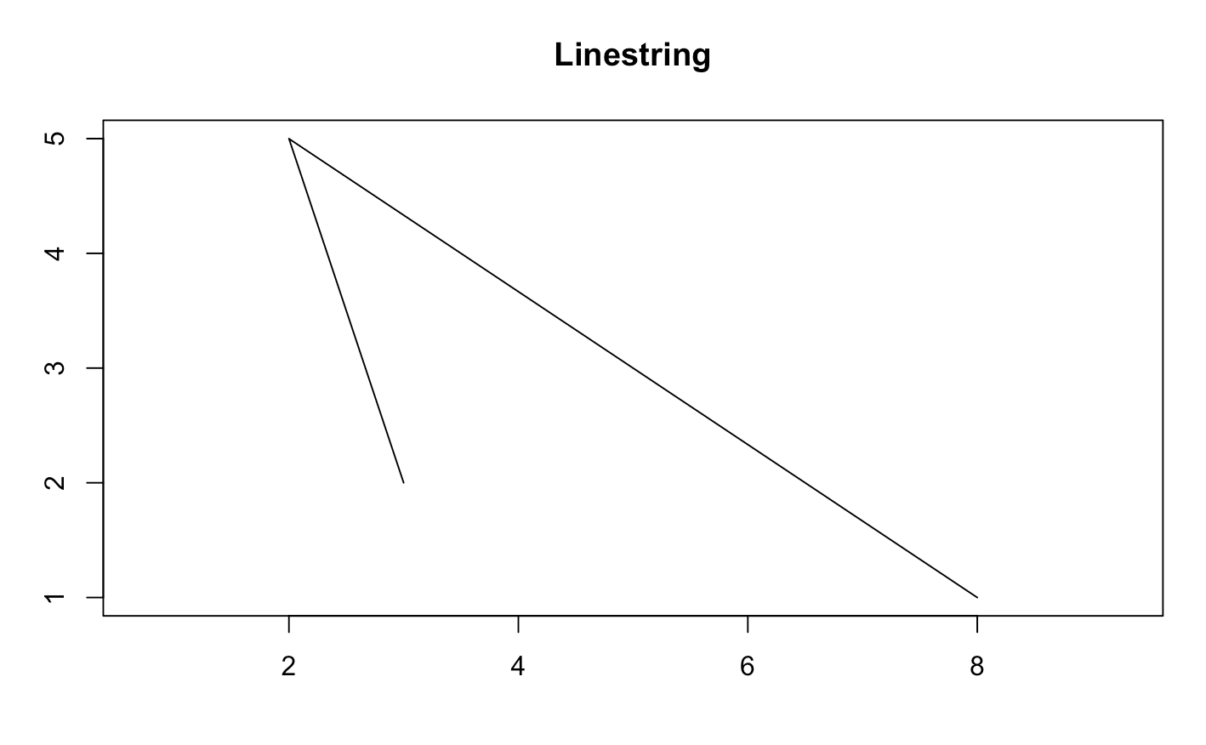
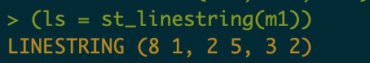
LINESTRING()
Single linestrings are made up of an ordered collection of POINTs() (two or more connected by straight lines)
Lines CANNOT self-intersect.
Create a point multipoint
2
WKT String
3
1

Slide 15
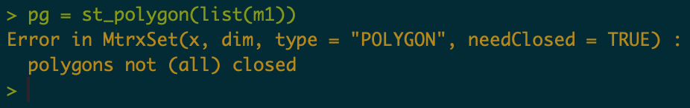
POLYGON()
Polygon rings must be closed (the last point equals the first)
Polygon holes (inner rings) must be inside their exterior ring
Inner rings shall maximally touch the exterior ring at a single point, not over a line
Polygon ring cannot repeat their own path
Is this a valid polygon?
If so, what shape does it make?
If not, why?

Slide 16
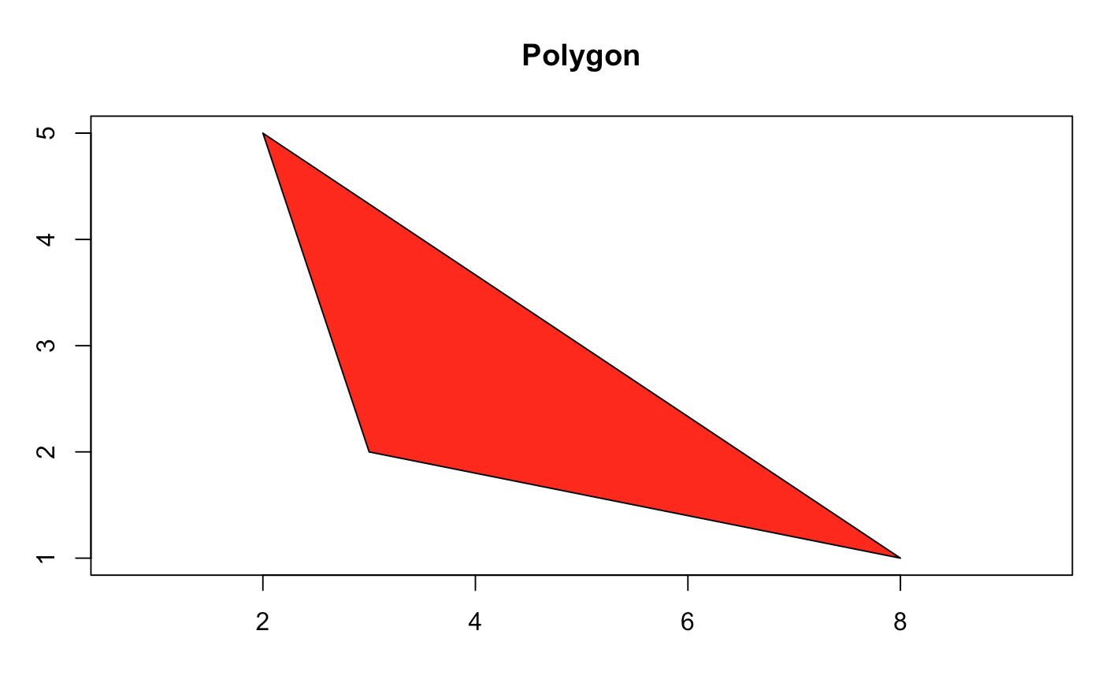
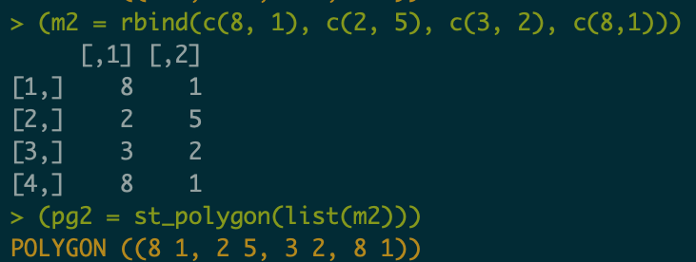
POLYGON()
Built in error handling…
You will not have this is your own Java implementations !
2
3
1,4

Slide 17
Homework hints …
Homework hints …
Part 2: Define POINT()s and determine the distance between them?
How is a POINT() defined? What components are needed?
How many POINT()s do you need to compute a distance operation?
How is distance in Cartesian space determined?

Slide 18
Homework hints …
Homework hints …
Part 3a: Define a LINESTRING()…
What are the minimum number of POINTS()s needed to define a LINESTRING() ?
Part 3b: Define a POLYGON()…
What is the minimum number of unique POINT()s needed to define a POLYGON() ?
What is the minimum number of POINT()s needed to initialize a POLYGON() ?
How many unique POINT()s are needed to define a valid LINESTRING() and POLYGON() ?

Slide 19
Homework hints …
Homework hints …
Part 4: Is the POLYGON() closed … aka … is it a valid geometry??
Think of this is building your own error handling
What conditional statement is needed to generate a warning like:

